Slide 1
Project Review (Zeroth Review)
FAKE JOB POST DETECTION USING DEEP LEARNING
Presented By:
V.Shanmugapriyan(E22ASR053)
C.Siva Prakash(E22ASR055)
Z.Aquib Javid(E22ASR035)
Project Supervisor:
DR. S. Palani Murugan (HOD)
AI&DS - Department

Slide 2
Introduction
In recent years, many people apply for jobs through online platforms like job portals and social media. But, this has also increased the number of fake job postings, where scammers cheat job seekers for money or personal details.
To solve this issue, our project uses deep learning techniques like (BERT) and (RoBERTa) to automatically detect fake job ads based on their content.
We also handle the imbalance in real vs fake job data using advanced methods like SMOTE, which helps improve the model's accuracy in catching scams. This system aims to protect users from falling into job fraud traps

Slide 3
Motivation
Why was this project chosen
Real-World Problem
Feature-Rich Data
High Social Impact
Automation & Efficiency
How did you manage to identify the need of the project
Real-Life Incidents
Statistical Evidence
User Feedback & Complaints
Technological Advancements

Slide 4
Problem Identified
What is the process adopted to identify the problem
Observing Real-World Issues
Collecting Data & Reports
Job Seekers Feedback
Analyzing Existing Systems
What is the need to solve it
Job Seekers Safety
Manual Verification Issues
Reducing Online Employment Scams
Time & Effort

Slide 5
Problem Identified
How do you manage to solve it
Deep Learning-Based approach
Data Collection & Preprocessing
NLP & Pattern Analysis
Model Training & Evaluation
Scope with solution
Scope of project
Detect fraudulent job postings on online recruitment platforms using deep learning.
Automate detection process to Reduce human effort.
Improve trust and safety for job seekers in online platforms.

Slide 6
Solution
Analyze job postings (description + metadata)
Preprocess text using NLP - Removing stop words (like "the", "an", "is")
Train Deep Learning models (like LSTM) to detect fraud patterns
Evaluate model performance
Deploy a system

Slide 7
Base Paper Details
Title of the paper: Online Recruitment Fraud (ORF) Detection Using Deep Learning Approaches
Journal Name: IEEE Access
Publication date : 30 July 2024
Author name : Natasa Akram, Rabia Irfan, Muhammad Imran

Slide 8
Literature Review
S.NO | Author Name | Year | Title of the Paper | Findings
1 | Tejasva Bhatia | 2022 | Detection of fake online recruitment using machine learning | Used NB, SVM, DT, KNN
2 | Alandjani et al. | 2022 | Job Scam Detection Using ML | KNN performed best among DT, RF, NB.

Slide 9
Key Business Objectives
Clear & Measurable Goals –Accurately identify and classify fraudulent job postings with >90% precision.
Customer Satisfaction – Increase trust and safety for job seekers using online platforms.
Revenue Growth – Prevent revenue loss due to fraud-related issues.
Competitive Edge – Use advanced AI (BERT, RoBERTa, SMOTE) to outperform traditional fraud detection methods.

Slide 10
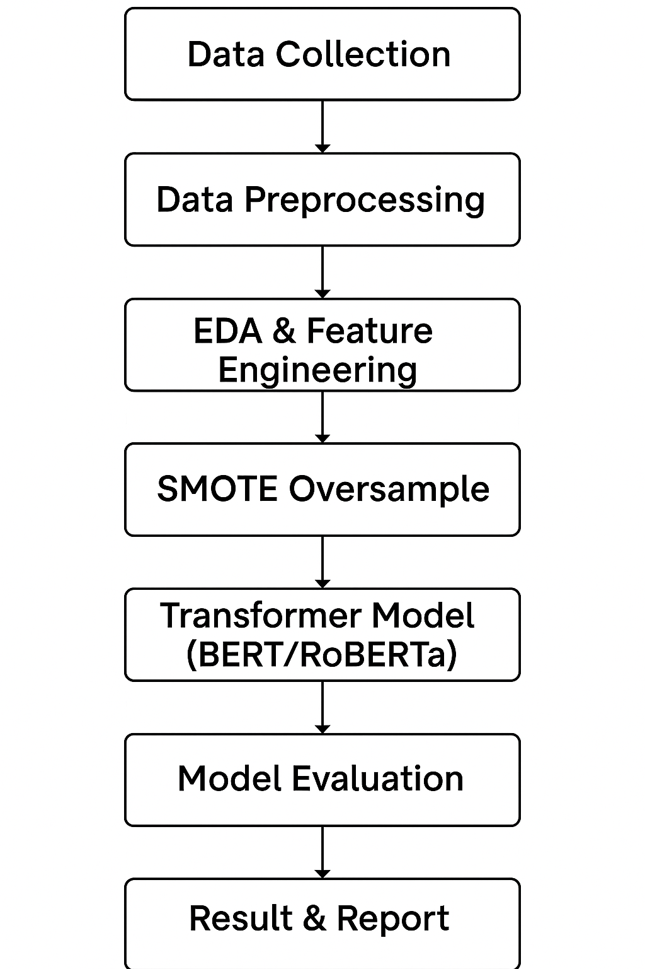
Methodology

Slide 11
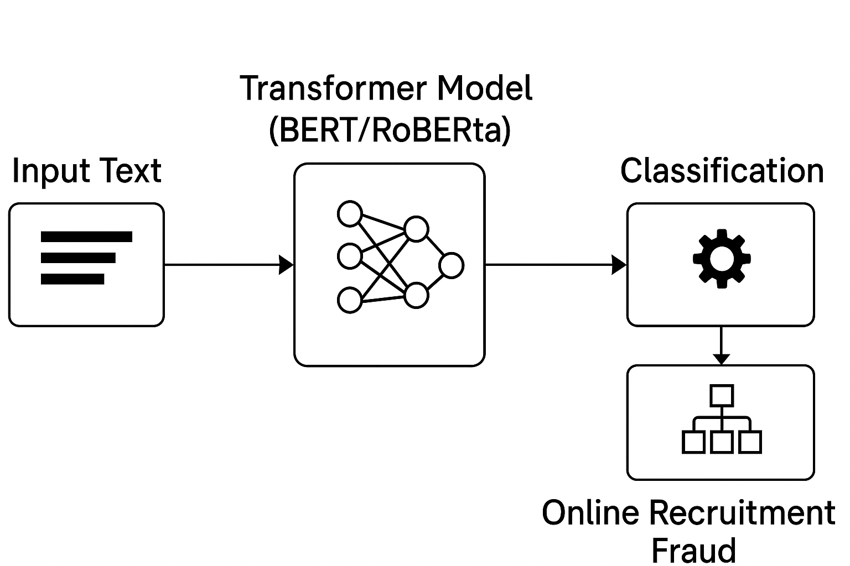
Diagram

Slide 12
Hardware and software
Software
Python (3.8+)
Jupyter Notebook / VS Code
PyTorch / TensorFlow
Pandas, NumPy
Hardware
Processor - Intel i3 / AMD Ryzen 3
RAM - 8 GB
OS - Windows / Linux / Mac
Storage - 20 GB (HDD/SSD)

Slide 13
Literature review link:
https://docs.google.com/document/d/1iyGVW9pVcSuyKh-3CCqZo9H1vX02t0diIP6RRA3aAYo/edit?usp=sharing
Base paper link:
https://doi.org/10.1109/ACCESS.2024.3435670

Slide 14
THANK YOU

